Slide 1
Statistical Models for Networks
https://tinyurl.com/SN-H2018

Slide 2
Statistical Models for Networks
overview
Types of inference problems
Randomization & Random graphs
Network as independent variables
QAP (& similar)
Network as dependent variables
Comparison to random graphs
Parametrically random graphs: ERGMs
Latent Space Networks
Multiplicative Effects Networks (AMEN)

Slide 3
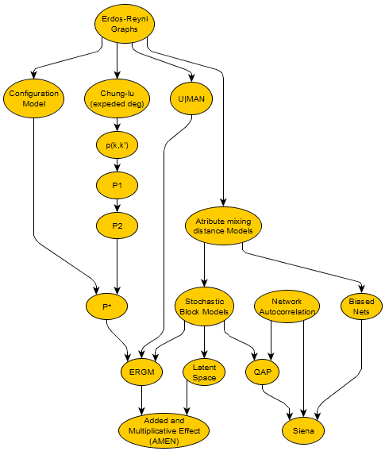
Statistical Models for Networks
Simple Random Graphs
Long history of model development for networks.
We cover a subset, focusing mainly on recent developments.

Slide 4
Statistical Models for Networks
Inference problems
Network inference differs from many of the inference problems we are used to.
We have the population (by assumption)
Want to know what the process underlying network formation might be
Random graphs thus create one (reasonable?) comparison group.
Questions are
“Would we see the observed graph if the process was random?”
“Is the observed structure random conditional on some feature?”
Common association tests (correlations, regressions, etc.) – or at least the inference tests for them -- assume case independence; randomization provides a non-parametric way to evaluate statistical significance, since the standard formulas will not work.
Difficult to sample: There are few well-established ways to partially sample a network; though random graph tools are making that possible.
Simulate social processes. We often want to test measures, models or methods on a large collection of networks with known properties, but have no access to real data.

Slide 5
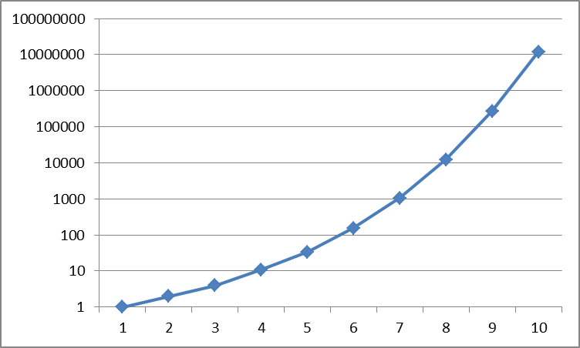
Statistical Models for Networks
Simple random graphs
Note a core difficulty: We want to compare our observed network to the class of all graphs (with similar properties), but we have no sampling frame of graphs.
That is we can think of this as either a graph of n nodes and assume all edges have equal probability of being present (G(N,p)) or we can imagine a (set of) graph(s) chosen at random from the set of all graphs with n nodes and m edges (G(N,M)).
But, enumeration is usually impossible…so we use construction rules that ensure even probability of all graphs in the space.
Number of unique undirected graph patterns by number of nodes
* Note a subtle difference here: the G(N,P) model will have random variability in number of edges due to random chance…ignorable in limit of large networks.

Slide 6
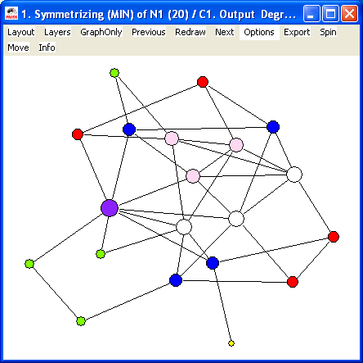
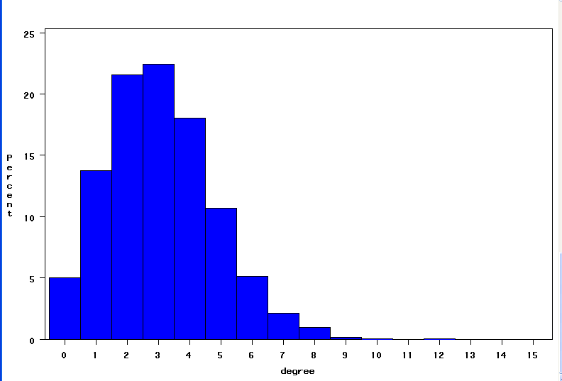
Statistical Models for Networks
Simple Random Graphs
In a Erdos random graph - each dyad has the same probability of being tied –so algorithm is a simple coin-flip on each dyad.
degree will be Poisson distributed, and the nodes with high degree are likely to be at the intuitive center.

Slide 7
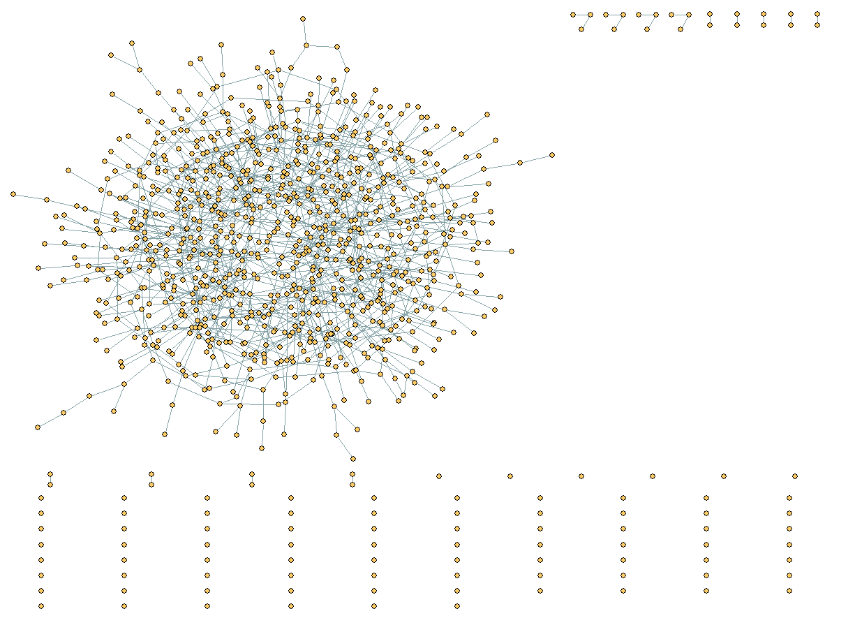
Statistical Models for Networks
Simple Random Graphs
Simple random graph with 1000 nodes and average degree=2.4 → p=0.0024.

Slide 8
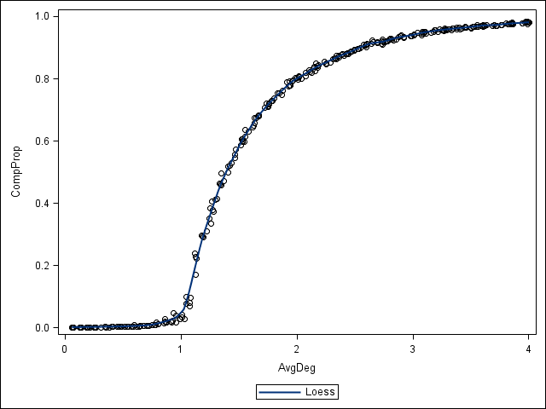
Statistical Models for Networks
Simple Random Graphs
Network connectivity changes rapidly as a function of network volume.
In a Erdos-reyni random network, when the average degree is <1, the network is always disconnected. When it is >2, there is a “giant component” that takes up most of the network.
Note that this is dependent on mean degree, not density, so applies to networks of any size.
Average Degree

Slide 9
Statistical Models for Networks
Less Random Graphs
Simple random is a very poor model for real life, so not really a fair null. Imagine you know the mixing by category in a network, you can use that to generate a network that has correct probability by mixing category:
We can condition on more features – degree distribution, dyad distribution, mixing…
These can take us a long ways towards getting a reasonable null.
Some are easy:
Have analytic solution to some features on some conditionals (like the “configuration model” used for building a null in community detection)
Good algorithms exist for fixing both in & out degree
generate a set of half-edges for each node’s degree, randomly sort, put back together
Often a tradeoff between *exact* uniform random & speed/tractabiltiy

Slide 10
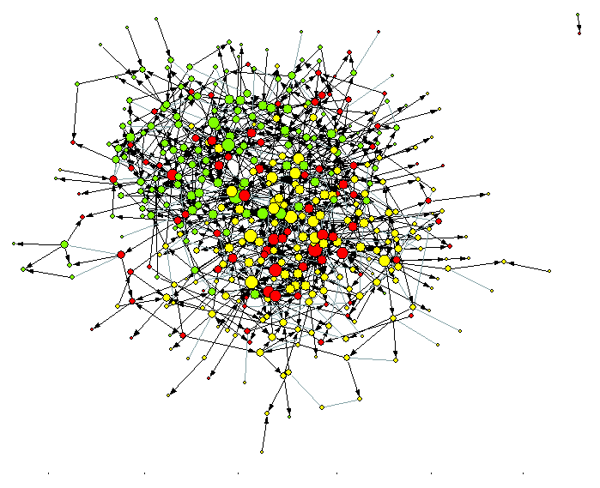
Statistical Models for Networks
Less Random Graphs
Simple random is a very poor model for real life, so not really a fair null. Imagine you know the mixing by category in a network, you can use that to generate a network that has correct probability by mixing category:
mixprob
wht blk oth
wht .0096 .0016 .0065
blk .0013 .0085 .0045
oth .0054 .0045 .0067
…so generate a random graph with similar mixing probability
Observed

Slide 11
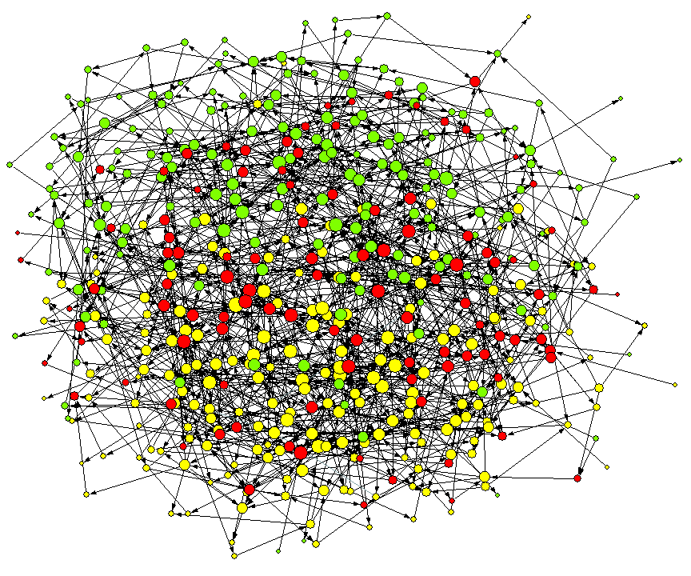
Statistical Models for Networks
Less Random Graphs
Simple random is a very poor model for real life, so not really a fair null. Imagine you know the mixing by category in a network, you can use that to generate a network that has correct probability by mixing category:
mixprob
wht blk oth
wht .0096 .0016 .0065
blk .0013 .0085 .0045
oth .0054 .0045 .0067
…so generate a random graph with similar mixing probability
Random

Slide 12
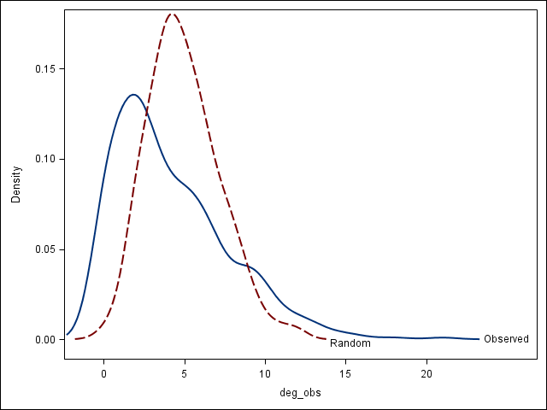
Statistical Models for Networks
Less Random Graphs
Simple random is a very poor model for real life, so not really a fair null. Imagine you know the mixing by category in a network, you can use that to generate a network that has correct probability by mixing category:
mixprob
wht blk oth
wht .0096 .0016 .0065
blk .0013 .0085 .0045
oth .0054 .0045 .0067
Degree distributions don’t match
…so generate a random graph with similar mixing probability

Slide 13
Statistical Models for Networks
Less Random Graphs
Random Reachability:
By number of close friends
100%
Degree = 4
Degree = 3
80%
Degree = 2
60%
Percent Contacted
40%
20%
0
0
1
2
3
4
5
6
7
8
9
10
11
12
13
14
15
Remove

Slide 14
Statistical Models for Networks
Less Random Graphs
Random graph
Observed

Slide 15
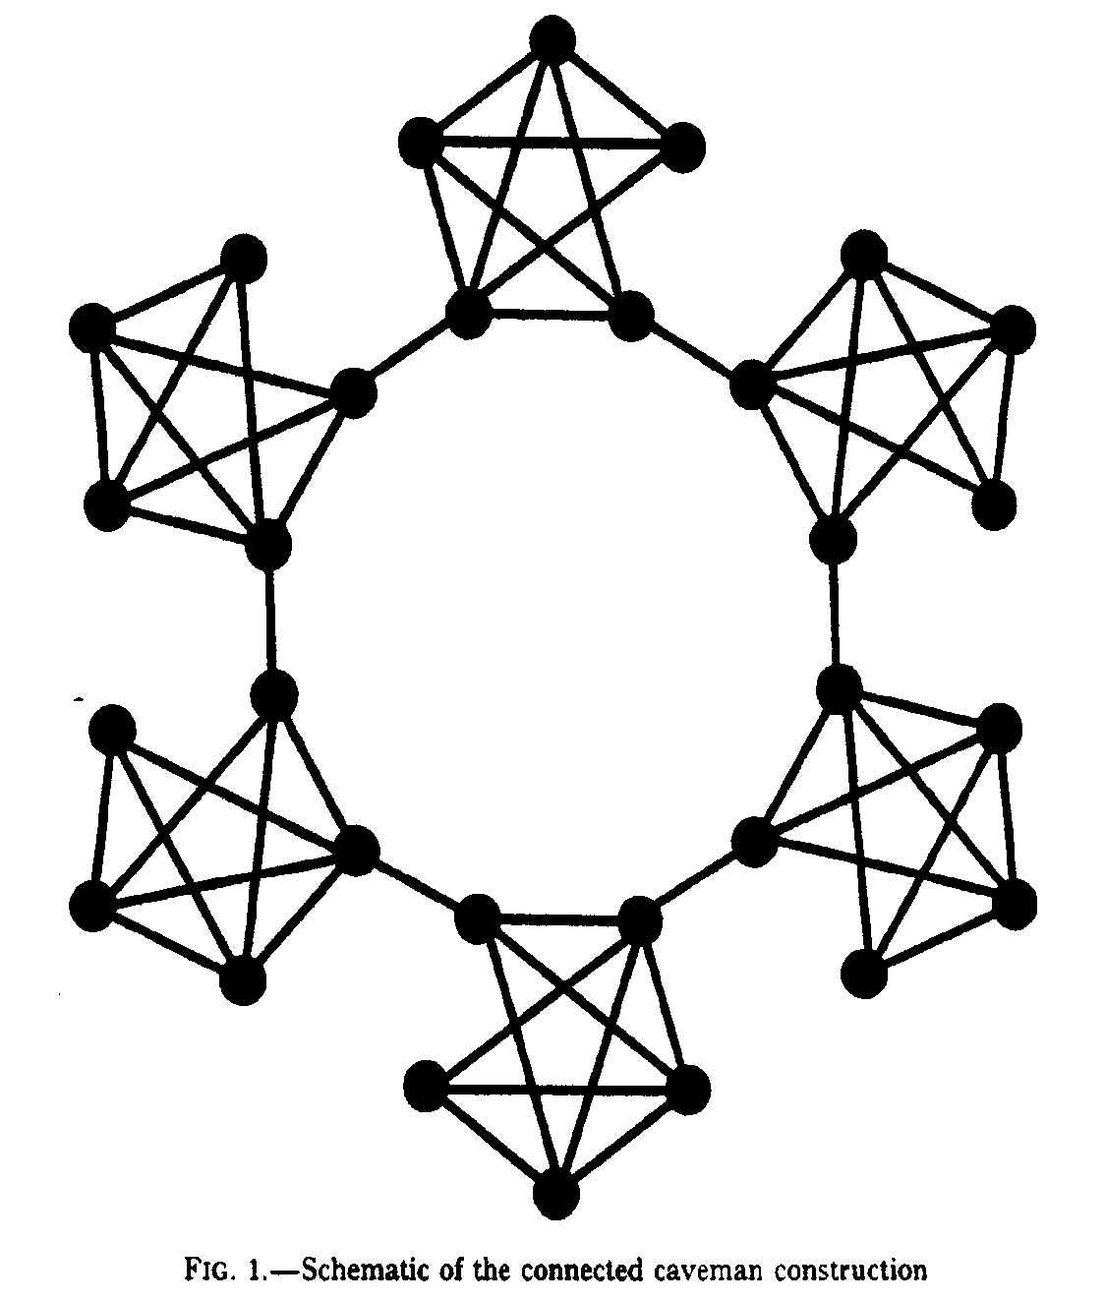
Statistical Models for Networks
Less Random Graphs
The most clustered graph is Watt’s “Caveman” graph:
Compared to random graphs, C is large and L is long. The intuition, then, is that clustered graphs tend to have (relatively) long characteristic path lengths.
The small world phenomenon rests on the opposite: high clustering and short path distances.
How?

Slide 16
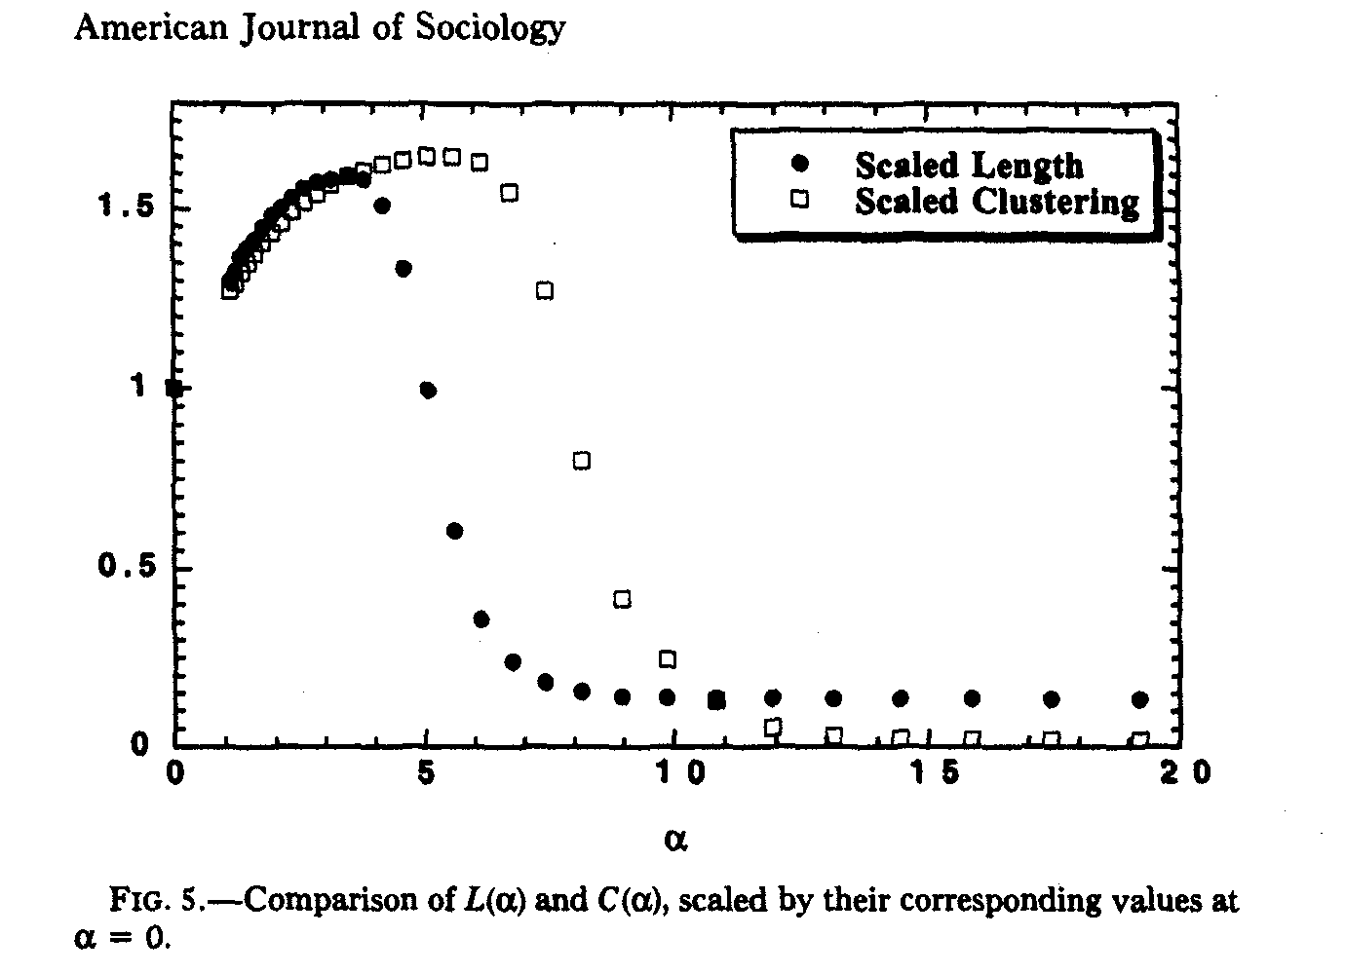
Statistical Models for Networks
Less Random Graphs
Simulate networks with a parameter (α) that governs the proportion of ties that are clustered compared to the proportion that are randomly distributed across the network:
C=Large, L is Small =
SW Graphs

Slide 17
Statistical Models for Networks
Less Random Graphs
PAJEK gives you the unconditional expected values:
------------------------------------------------------------------------------
Triadic Census 2. i:\people\jwm\s884\homework\prison.net (67)
------------------------------------------------------------------------------
Working...
----------------------------------------------------------------------------
Type Number of triads (ni) Expected (ei) (ni-ei)/ei
----------------------------------------------------------------------------
1 - 003 39221 37227.47 0.05
2 - 012 5860 9587.83 -0.39
3 - 102 2336 205.78 10.35
4 - 021D 61 205.78 -0.70
5 - 021U 80 205.78 -0.61
6 - 021C 103 411.55 -0.75
7 - 111D 105 17.67 4.94
8 - 111U 69 17.67 2.91
9 - 030T 13 17.67 -0.26
10 - 030C 1 5.89 -0.83
11 - 201 12 0.38 30.65
12 - 120D 15 0.38 38.56
13 - 120U 7 0.38 17.46
14 - 120C 5 0.76 5.59
15 - 210 12 0.03 367.67
16 - 300 5 0.00 21471.04
----------------------------------------------------------------------------
Chi-Square: 137414.3919***
6 cells (37.50%) have expected frequencies less than 5.
The minimum expected cell frequency is 0.00.

Slide 18
Statistical Models for Networks
Less Random Graphs
But formulas are known to calculate expected triad counts under multiple Null distributions, such as the (U|MAN) distributions:
Triad Census
T TPCNT PU EVT VARTU STDDIF
003 39221 0.8187 0.8194 39251 427.69 -1.472
012 5860 0.1223 0.1213 5810.8 1053.5 1.5156
102 2336 0.0488 0.0476 2278.7 321.01 3.1954
021D 61 0.0013 0.0015 70.949 67.37 -1.212
021U 80 0.0017 0.0015 70.949 67.37 1.1027
021C 103 0.0022 0.003 141.9 127.58 -3.444
111D 105 0.0022 0.0023 112.39 103.57 -0.727
111U 69 0.0014 0.0023 112.39 103.57 -4.264
030T 13 0.0003 0.0001 3.4292 3.3956 5.1939
030C 1 209E-7 239E-7 1.1431 1.1393 -0.134
201 12 0.0003 0.0009 42.974 38.123 -5.017
120D 15 0.0003 286E-7 1.3717 1.368 11.652
120U 7 0.0001 286E-7 1.3717 1.368 4.8122
120C 5 0.0001 573E-7 2.7433 2.7285 1.3662
210 12 0.0003 442E-7 2.1186 2.1023 6.8151
300 5 0.0001 549E-8 0.2631 0.2621 9.2522

Slide 19
Introduction to Random & Stochastic
Applications
Network Sub-Structure: Triads
(0)
(1)
(2)
(3)
(4)
(5)
(6)
003
012
102
111D
201
210
300
021D
111U
120D
Intransitive
Transitive
021U
030T
120U
Mixed
021C
030C
120C

Slide 20
Introduction to Random & Stochastic
Applications
Triad Census Distributions
Standardized Difference from Expected
Data from Add Health
400
300
200
t-value
100
0
-100
012
102
021D
021U
021C
111D
111U
030T
030C
201
120D
120U
120C
210
300

Slide 21
Introduction to Random & Stochastic
Applications
Prosper
Notes:
Here we have box-plots for 4 different hierarchy models. The first two assume perfect Mutual-cliques within the tightes clusters, the last two assume chain-mutuallyi. These last 3 models are the best-fitting, over the pure “ranked-clusters of M Cliques” model. The main issue is that (a) we likley have less than perfect cliques within clusters and (b) we likely have multiple hierarchies…
The take-home here is that we have strong evidence from both the distribution of degree and the distribution of triads (and a long body of theory on schools!) that these settings are hierarchically ordered, with those receiving the most nominations at the “top” of the status hierarchy.

Slide 22
Statistical Models for Networks
Less Random Graphs - simulated
Edge-matching random permutation
Can easily generate networks with appropriate degree distributions by generating “edge stems” and sorting:
d_{i}=1
d_{i}=2
d_{i}=3
Degree:
1: 2
2: 2
3: 1
a
c
f
b
c
f
d
f
d
(need to ensure you have a valid edge list!)

Slide 23
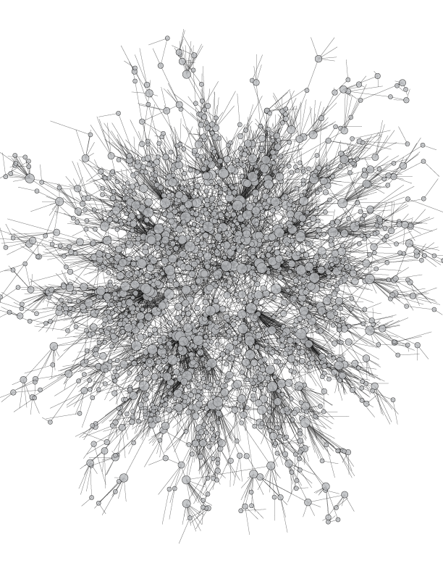
Statistical Models for Networks
Less Random Graphs

Slide 24
Statistical Models for Networks
Less Random Graphs
So the answer to the inference problem is to construct a reasonable approximation to your observed setting (or social process) and compare.
There are many ways to conceive of “reasonable” and many ways to construct each.
When possible, use analytic solutions; but that’s rarely possible for realistic comparisons.

Slide 25
Statistical Models for Networks
Randomization – Net as independent variable
Comparing multiple networks: QAP
The substantive question is how one set of relations (or dyadic attributes) relates to another.
For example:
Do marriage ties correlate with business ties in the Medici family network?
Are friendship relations correlated with joint membership in a club?

Slide 26
Statistical Models for Networks
Randomization – Net as independent variable
Assessing the correlation is straight forward, as we simply correlate each corresponding cell of the two matrices:
Dyads:
1 2 0 0
1 3 0 0
1 4 0 0
1 5 0 0
1 6 0 0
1 7 0 0
1 8 0 0
1 9 1 0
1 10 0 0
1 11 0 0
1 12 0 0
1 13 0 0
1 14 0 0
1 15 0 0
1 16 0 0
2 1 0 0
2 3 0 0
2 4 0 0
2 5 0 0
2 6 1 0
2 7 1 0
2 8 0 0
2 9 1 0
2 10 0 0
2 11 0 0
2 12 0 0
2 13 0 0
2 14 0 0
2 15 0 0
2 16 0 0
Marriage
1 ACCIAIUOL 0 0 0 0 0 0 0 0 1 0 0 0 0 0 0 0
2 ALBIZZI 0 0 0 0 0 1 1 0 1 0 0 0 0 0 0 0
3 BARBADORI 0 0 0 0 1 0 0 0 1 0 0 0 0 0 0 0
4 BISCHERI 0 0 0 0 0 0 1 0 0 0 1 0 0 0 1 0
5 CASTELLAN 0 0 1 0 0 0 0 0 0 0 1 0 0 0 1 0
6 GINORI 0 1 0 0 0 0 0 0 0 0 0 0 0 0 0 0
7 GUADAGNI 0 1 0 1 0 0 0 1 0 0 0 0 0 0 0 1
8 LAMBERTES 0 0 0 0 0 0 1 0 0 0 0 0 0 0 0 0
9 MEDICI 1 1 1 0 0 0 0 0 0 0 0 0 1 1 0 1
10 PAZZI 0 0 0 0 0 0 0 0 0 0 0 0 0 1 0 0
11 PERUZZI 0 0 0 1 1 0 0 0 0 0 0 0 0 0 1 0
12 PUCCI 0 0 0 0 0 0 0 0 0 0 0 0 0 0 0 0
13 RIDOLFI 0 0 0 0 0 0 0 0 1 0 0 0 0 0 1 1
14 SALVIATI 0 0 0 0 0 0 0 0 1 1 0 0 0 0 0 0
15 STROZZI 0 0 0 1 1 0 0 0 0 0 1 0 1 0 0 0
16 TORNABUON 0 0 0 0 0 0 1 0 1 0 0 0 1 0 0 0
Business
1 0 0 0 0 0 0 0 0 0 0 0 0 0 0 0 0
2 0 0 0 0 0 0 0 0 0 0 0 0 0 0 0 0
3 0 0 0 0 1 1 0 0 1 0 1 0 0 0 0 0
4 0 0 0 0 0 0 1 1 0 0 1 0 0 0 0 0
5 0 0 1 0 0 0 0 1 0 0 1 0 0 0 0 0
6 0 0 1 0 0 0 0 0 1 0 0 0 0 0 0 0
7 0 0 0 1 0 0 0 1 0 0 0 0 0 0 0 0
8 0 0 0 1 1 0 1 0 0 0 1 0 0 0 0 0
9 0 0 1 0 0 1 0 0 0 1 0 0 0 1 0 1
10 0 0 0 0 0 0 0 0 1 0 0 0 0 0 0 0
11 0 0 1 1 1 0 0 1 0 0 0 0 0 0 0 0
12 0 0 0 0 0 0 0 0 0 0 0 0 0 0 0 0
13 0 0 0 0 0 0 0 0 0 0 0 0 0 0 0 0
14 0 0 0 0 0 0 0 0 1 0 0 0 0 0 0 0
15 0 0 0 0 0 0 0 0 0 0 0 0 0 0 0 0
16 0 0 0 0 0 0 0 0 1 0 0 0 0 0 0 0
Correlation:
1 0.3718679
0.3718679 1

Slide 27
Statistical Models for Networks
Randomization – Net as independent variable
But is the observed value statistically significant?
Can’t use standard inference, since the assumptions are violated. Instead, we use a permutation approach.
Essentially, we are asking whether the observed correlation is large (small) compared to that which we would get if the assignment of variables to nodes were random, but the interdependencies within variables were maintained.
Do this by randomly sorting the rows and columns of the matrix, then re-estimating the correlation.

Slide 28
Statistical Models for Networks
Randomization – Net as independent variable
Comparing multiple networks: QAP
When you permute, you have to permute both the rows and the columns simultaneously to maintain the interdependencies in the data:
ID ORIG
A 0 1 2 3 4
B 0 0 1 2 3
C 0 0 0 1 2
D 0 0 0 0 1
E 0 0 0 0 0
Sorted
A 0 3 1 2 4
D 0 0 0 0 1
B 0 2 0 1 3
C 0 1 0 0 2
E 0 0 0 0 0

Slide 29
Statistical Models for Networks
Randomization – Net as independent variable
Procedure:
Calculate the observed correlation
for K iterations do:
a) randomly sort one of the matrices
b) recalculate the correlation
c) store the outcome
3. compare the observed correlation to the distribution of correlations created by the random permutations.

Slide 30
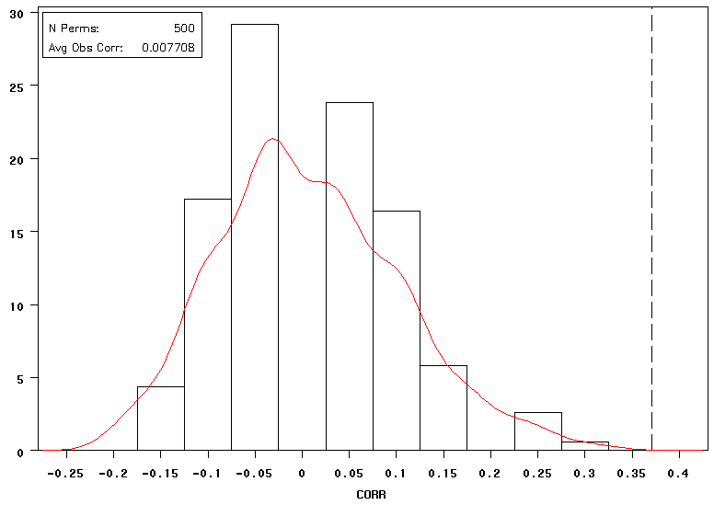
Statistical Models for Networks
Randomization – Net as independent variable

Slide 31
QAP MATRIX CORRELATION
--------------------------------------------------------------------------------
Observed matrix: PadgBUS
Structure matrix: PadgMAR
# of Permutations: 2500
Random seed: 356
Univariate statistics
1 2
PadgBUS PadgMAR
------- -------
1 Mean 0.125 0.167
2 Std Dev 0.331 0.373
3 Sum 30.000 40.000
4 Variance 0.109 0.139
5 SSQ 30.000 40.000
6 MCSSQ 26.250 33.333
7 Euc Norm 5.477 6.325
8 Minimum 0.000 0.000
9 Maximum 1.000 1.000
10 N of Obs 240.000 240.000
Hubert's gamma: 16.000
Bivariate Statistics
1 2 3 4 5 6 7
Value Signif Avg SD P(Large) P(Small) NPerm
--------- --------- --------- --------- --------- --------- ---------
1 Pearson Correlation: 0.372 0.000 0.001 0.092 0.000 1.000 2500.000
2 Simple Matching: 0.842 0.000 0.750 0.027 0.000 1.000 2500.000
3 Jaccard Coefficient: 0.296 0.000 0.079 0.046 0.000 1.000 2500.000
4 Goodman-Kruskal Gamma: 0.797 0.000 -0.064 0.382 0.000 1.000 2500.000
5 Hamming Distance: 38.000 0.000 59.908 5.581 1.000 0.000 2500.000
This can be done simply in UCINET & R

Slide 32
Statistical Models for Networks
Randomization – Net as independent variable
Using the same logic,we can estimate alternative models, such as regression, logits, probits, etc. Only complication is that you need to permute all of the independent matrices in the same way each iteration.

Slide 33
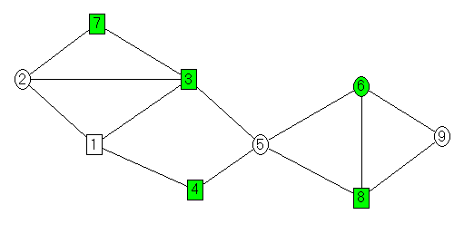
Statistical Models for Networks
Randomization – Net as independent variable
NODE ADJMAT SAMERCE SAMESEX
1 0 1 1 1 0 0 0 0 0 0 1 0 0 1 0 0 0 1 0 0 1 1 0 0 1 1 0
2 1 0 1 0 0 0 1 0 0 1 0 0 0 1 0 0 0 1 0 0 0 0 1 1 0 0 1
3 1 1 0 0 1 0 1 0 0 0 0 0 1 0 1 1 1 0 1 0 0 1 0 0 1 1 0
4 1 0 0 0 1 0 0 0 0 0 0 1 0 0 1 1 1 0 1 0 1 0 0 0 1 1 0
5 0 0 1 1 0 1 0 1 0 1 1 0 0 0 0 0 0 1 0 1 0 0 0 1 0 0 1
6 0 0 0 0 1 0 0 1 1 0 0 1 1 0 0 1 1 0 0 1 0 0 1 0 0 0 1
7 0 1 1 0 0 0 0 0 0 0 0 1 1 0 1 0 1 0 1 0 1 1 0 0 0 1 0
8 0 0 0 0 1 1 0 0 1 0 0 1 1 0 1 1 0 0 1 0 1 1 0 0 1 0 0
9 0 0 0 0 0 1 0 1 0 1 1 0 0 1 0 0 0 0 0 1 0 0 1 1 0 0 0

Slide 34
Statistical Models for Networks
Randomization – Net as independent variable
Y
0.32
0.59
0.54
0.50
0.04
0.02
0.41
0.01
-0.17
Distance (D_{ij}=abs(Y_{i}-Y_{j})
.000 .277 .228 .181 .278 .298 .095 .307 .481
.277 .000 .049 .096 .555 .575 .182 .584 .758
.228 .049 .000 .047 .506 .526 .134 .535 .710
.181 .096 .047 .000 .459 .479 .087 .488 .663
.278 .555 .506 .459 .000 .020 .372 .029 .204
.298 .575 .526 .479 .020 .000 .392 .009 .184
.095 .182 .134 .087 .372 .392 .000 .401 .576
.307 .584 .535 .488 .029 .009 .401 .000 .175
.481 .758 .710 .663 .204 .184 .576 .175 .000

Slide 35

Statistical Models for Networks
Randomization – Net as independent variable

Slide 36
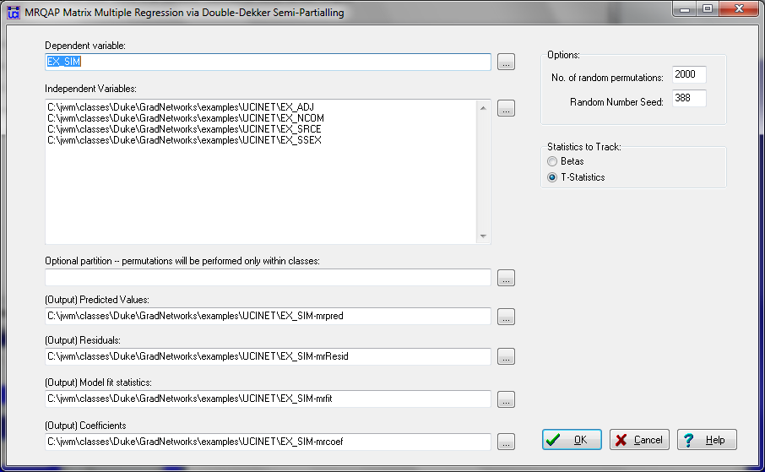
Statistical Models for Networks
Randomization – Net as independent variable

Slide 37
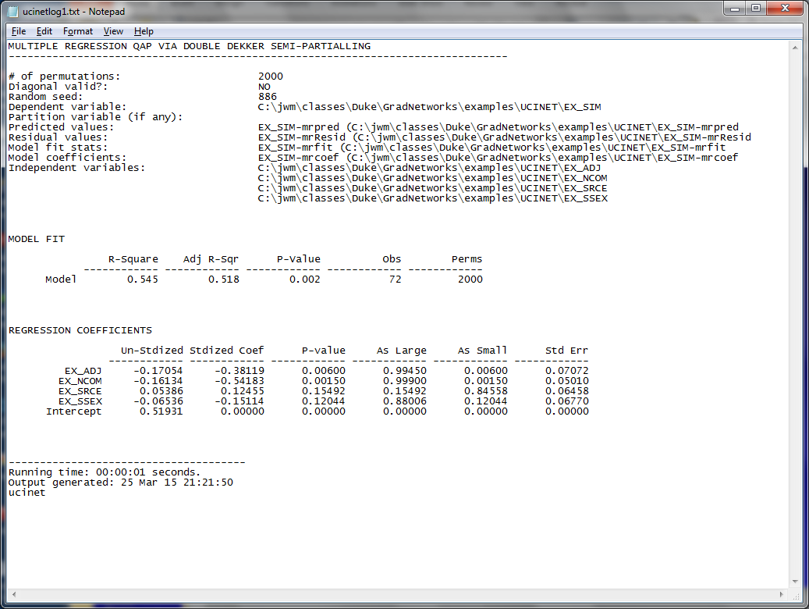
Statistical Models for Networks
Randomization – Net as independent variable

Slide 38
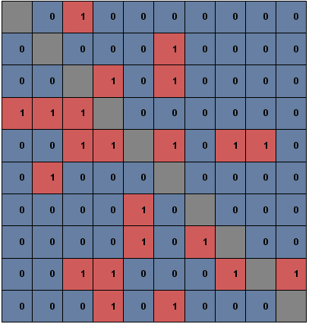
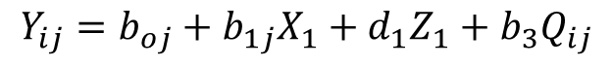
Statistical Models for Networks
Modeling the network
Oftentimes our goal is to predict the network itself, or a process on the network. We can use QAP/randomization tricks like we describe above; but those are often difficult to generalize across many dimensions. Instead, we can build a statistical model of the network.
Observed Network
Goal is to build a probability model for edges in the network (Y_{ij}) as a function of features of i (X), features of j(Z) and dyad-specific features (Q).
For now, think of this as a simple logit model:
$$Y_{ij}=b_{oj}+b_{1j}X_{1}+d_{1}Z_{1}+b_{3}Q_{ij}$$

Slide 39
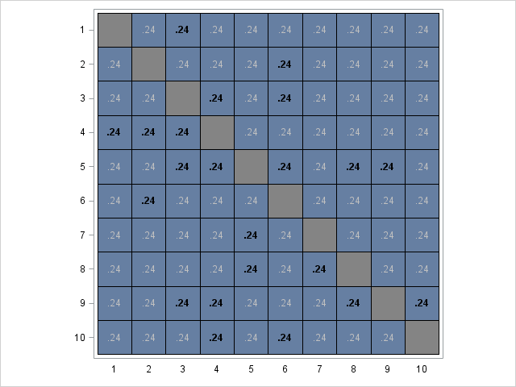
Statistical Models for Networks
Modeling the network
Goal is to build a probability model for edges in the network (Y_{ij}) as a function of features of i (X), features of j(Z) and dyad-specific features (Q).
Intercept only model:
$$Y_{ij}=b_{oj}+b_{1j}X_{1}+d_{1}Z_{1}+b_{3}Q_{ij}$$
Parameter | Estimate
Intercept | -1.13
All cells equal to density of the network

Slide 40
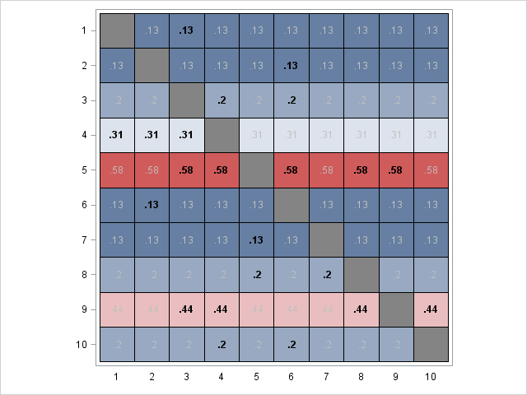
Statistical Models for Networks
Modeling the network
Goal is to build a probability model for edges in the network (Y_{ij}) as a function of features of i (X), features of j(Z) and dyad-specific features (Q).
Add Sender effects
$$Y_{ij}=b_{oj}+b_{1j}X_{1}+d_{1}Z_{1}+b_{3}Q_{ij}$$
Parameter | Estimate
Intercept | -2.51
Sender Degree | 0.57
Sum of the rows will equal sender degree, p_{ij} constant across columns

Slide 41
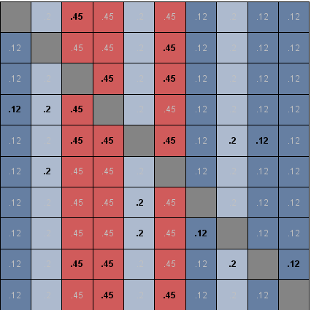
Statistical Models for Networks
Modeling the network
Goal is to build a probability model for edges in the network (Y_{ij}) as a function of features of i (X), features of j(Z) and dyad-specific features (Q).
or Target effects
$$Y_{ij}=b_{oj}+b_{1j}X_{1}+d_{1}Z_{1}+b_{3}Q_{ij}$$
Parameter | Estimate
Intercept | -2.57
Target Degree | 0.59
Sum of the columns will equal target in-degree, p_{ij} constant across rows

Slide 42
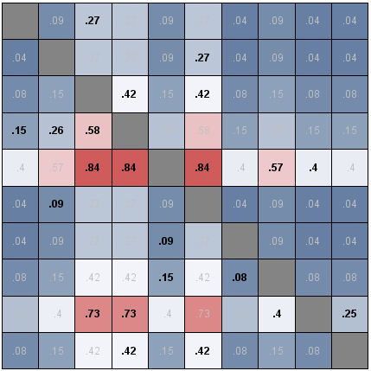
Statistical Models for Networks
Modeling the network
Goal is to build a probability model for edges in the network (Y_{ij}) as a function of features of i (X), features of j(Z) and dyad-specific features (Q).
or both marginal effects
$$Y_{ij}=b_{oj}+b_{1j}X_{1}+d_{1}Z_{1}+b_{3}Q_{ij}$$
Or both sender & target effects
Parameter | Estimate
Intercept | -4.15
Sender Degree | 0.66
Target Degree | 0.69
Cells with same marginal sums will be the same

Slide 43
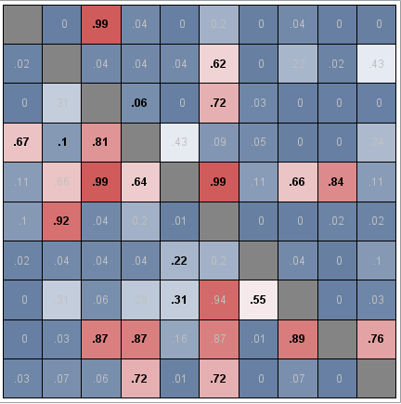
Statistical Models for Networks
Modeling the network
Goal is to build a probability model for edges in the network (Y_{ij}) as a function of features of i (X), features of j(Z) and dyad-specific features (Q).
Add dyad-specific features
$$Y_{ij}=b_{oj}+b_{1j}X_{1}+d_{1}Z_{1}+b_{3}Q_{ij}$$
Full model has dyad-specific covariates
Parameter | Estimate
Intercept | -9.12
Sender Degree | 0.49
Target Degree | 0.87
Dyad Similarity | 1.86
Dyadic similarity sharpens fit within volume-specific dyads and allows us to capture either mixing features (same race, same sex, etc.) or structural features (reciprocity, shared friends, etc.).

Slide 44
Statistical Models for Networks
Modeling the network
Goal is to build a probability model for edges in the network (Y_{ij}) as a function of features of i (X), features of j(Z) and dyad-specific features (Q).
Add dyad-specific features
This simple model does OK…
- Bold cells tend to be high-probability

Slide 45
Statistical Models for Networks
Modeling the network
Goal is to build a probability model for edges in the network (Y_{ij}) as a function of features of i (X), features of j(Z) and dyad-specific features (Q).
Add dyad-specific features
This simple model does OK…
- Bold cells tend to be high-probability
- But some clear misses

Slide 46
Statistical Models for Networks
Modeling the network
Goal is to build a probability model for edges in the network (Y_{ij}) as a function of features of i (X), features of j(Z) and dyad-specific features (Q).
Add dyad-specific features
This simple model does OK…
- Bold cells tend to be high-probability
- But some clear misses
- and false positives

Slide 47
Statistical Models for Networks
Modeling the network
Goal is to build a probability model for edges in the network (Y_{ij}) as a function of features of i (X), features of j(Z) and dyad-specific features (Q).
Add dyad-specific features
This simple model does OK…
- Bold cells tend to be high-probability
- But some clear misses
- and false positives
We miss because (a) poor model specification or (b) poor model estimation.
Most of the work in the last few years has been on fixing these problems.

Slide 48
Statistical Models for Networks
Modeling the network: ERGM
A key twist on this simple model above is that while we work with dyads (i.e. our observations in the dataset will be ij dyads), the model is of the entire network – including all the dependencies.
Substantively, the approach is to ask whether the graph in question is an element of the class of all random graphs with the given known elements. For example, all graphs with 5 nodes and 3 edges, or, put probabilistically, the probability of observing the current graph given the conditions.

Slide 49
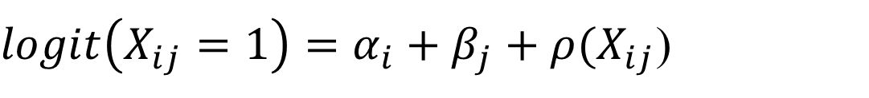
Statistical Models for Networks
Modeling the network: ERGM
The “p1” model of Holland and Leinhardt is the classic foundation – the basic idea is that you can generate a statistical model of the network by predicting the counts of types of ties (asym, null, sym). They formulate a log-linear model for these counts; but the model is equivalent to a logit model on the dyads:
$logit\left(X_{ij}=1\right)=α_{i}+β_{j}+ρ(X_{ij}$)
Note the subscripts! This implies a distinct parameter for every node i and j in the model, plus one for reciprocity.

Slide 50
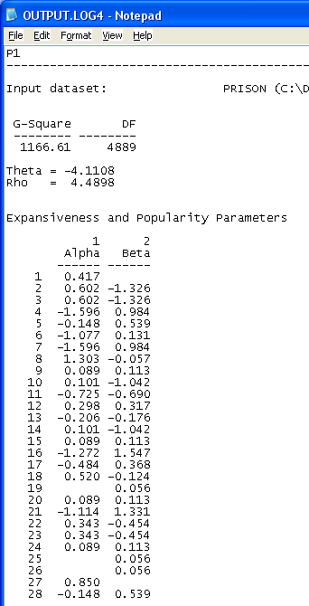
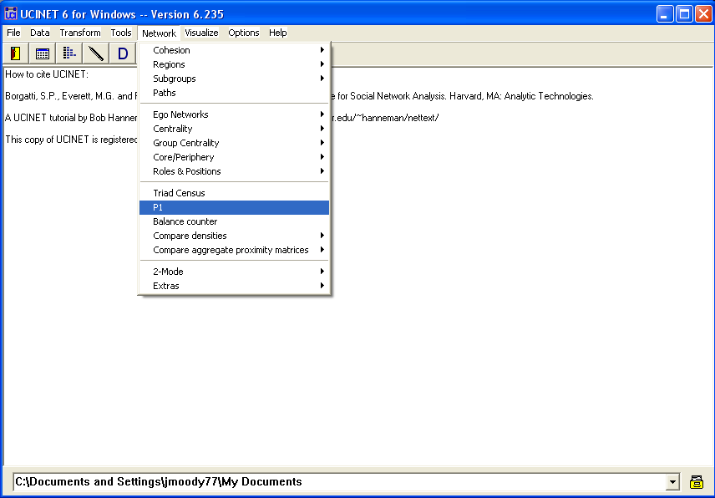
Statistical Models for Networks
Modeling the network: ERGM

Slide 51
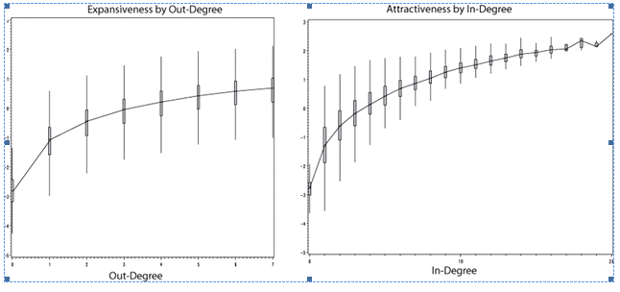
Statistical Models for Networks
Modeling the network: ERGM
Results from SAS version on PROSPER datasets

Slide 52
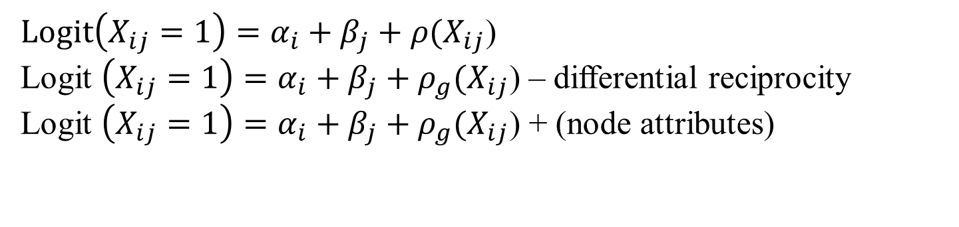
Statistical Models for Networks
Modeling the network: ERGM
Once you know the basic model format, you can imagine other specifications:
$Logit\left(X_{ij}=1\right)=α_{i}+β_{j}+ρ(X_{ij}$)
Logit $\left(X_{ij}=1\right)=α_{i}+β_{j}+ρ_{g}(X_{ij}$) – differential reciprocity
Logit $\left(X_{ij}=1\right)=α_{i}+β_{j}+ρ_{g}(X_{ij}$) + (node attributes)
Key is to ensure that the specification doesn’t imply a linear dependency of terms.
Model fit is hard to judge, and for all but the simplest rhs features, the se’s are “approximate.”
How to fix the inference problem?

Slide 53
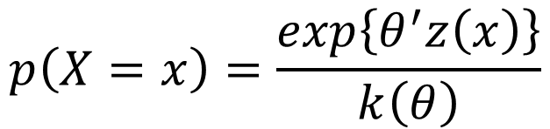
Statistical Models for Networks
Modeling the network: ERGM
Analytic & estimation solutions came with some careful thinking on the underlying structure on this model. Start with a re-expression of a general graph model:
$$p\left(X=x\right)=\frac{exp\left\{θ^{′}z\left(x\right)\right\}}{k\left(θ\right)}$$
Where:
θ is a vector of parameters (like regression coefficients)
z is a vector of network statistics, conditioning the graph
κ is a normalizing constant, to ensure the probabilities sum to 1.
So here, we’re just asking the probability of observing our network, given some network statistics.

Slide 54
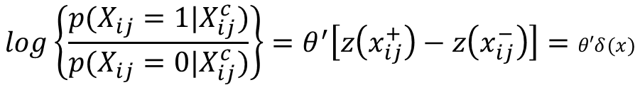
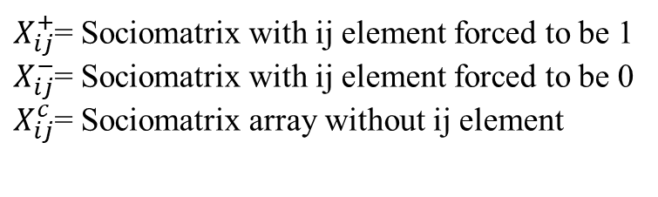
Statistical Models for Networks
Modeling the network: ERGM
We need a way to express the probability of the graph that doesn’t depend on that constant. It turns out we can do this by conditioning on a ‘complement’ graph.
First some terms:
$X_{ij}^{+}$= Sociomatrix with ij element forced to be 1
$X_{ij}^{−}$= Sociomatrix with ij element forced to be 0
$X_{ij}^{c}$= Sociomatrix array without ij element
After some algebra:
$$log\left\{\frac{p(X_{ij}=1|X_{ij}^{c})}{p(X_{ij}=0|X_{ij}^{c})}\right\}=θ^{′}\left[z\left(x_{ij}^{+}\right)−z\left(x_{ij}^{−}\right)\right]=θ′δ(x)$$
Which ends up being a logit model on z, where z are “change statistics” or counts of features on the full graph when that statistic for the ij dyad is differenced.

Slide 55
Statistical Models for Networks
Modeling the network: ERGM
Steps in estimating an ERGM
Specify the model
Fit the model
Examine MCMC chains for convergence & such
Examine Goodness of fit
If poor, return to 1
Else, publish your paper. ☺

Slide 56
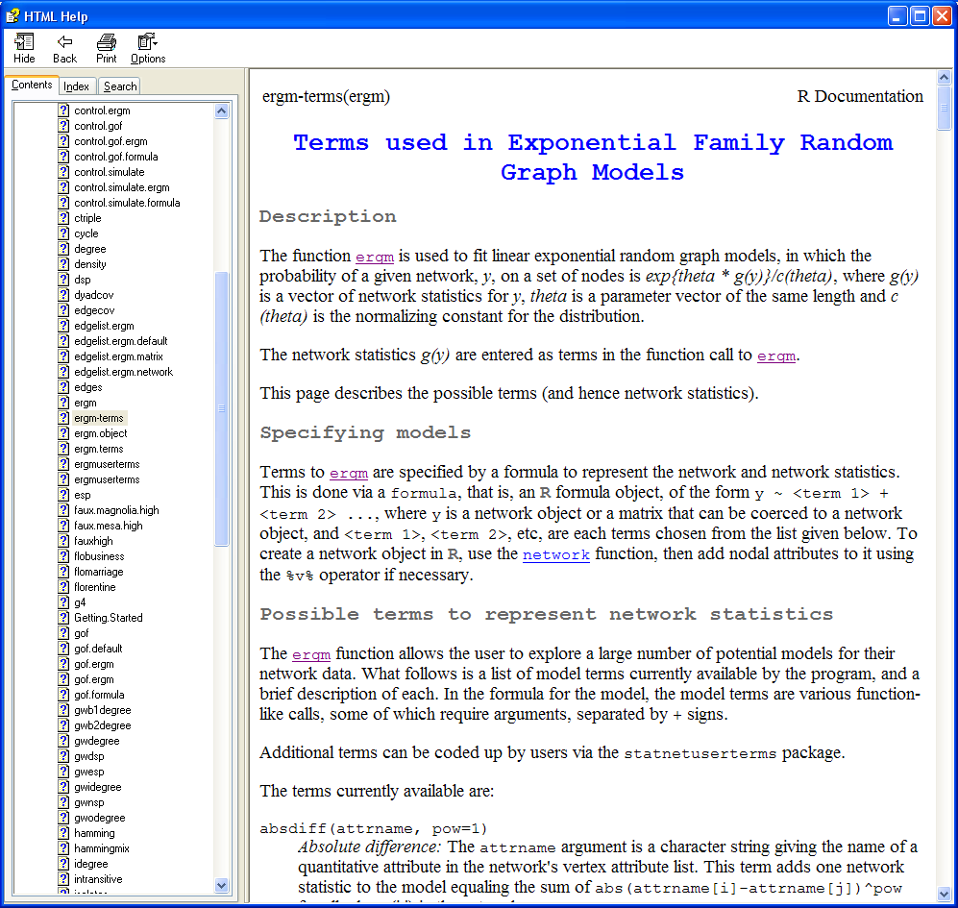
Statistical Models for Networks
ERGM: Model Specification
Question is the likelihood of a network given an observed set of network mixing statistics.
The set of such statistics (“terms”) is large…and growing.
Intuitively, these capture a social process you think is driving network formation.

Slide 57
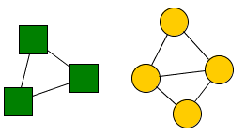
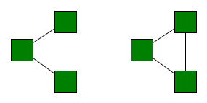
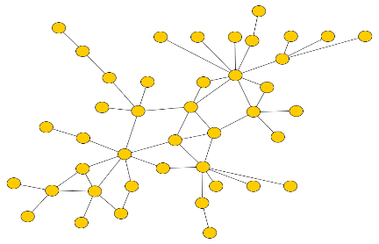
Statistical Models for Networks
ERGM: Model Specification
Structural
Signature
Theory
Colloquialism
Model Term
Homophily
NodeMatch()
Birds of a feather…
A friend of a friend...
A friend of an enemy…
Balance, Transitivity,
GWESP
Social Balance
Don’t I know your…
or
Kevin Bacon game…
Clustering & k-paths
Small-Worlds
In-degree, k-stars
Preferential
Attachment
Rich get richer..
First mover advantage

Slide 58
Statistical Models for Networks
ERGM: Model Specification
Common classes of terms:
Term | Why?
Edges | Density
Receiver, Sender | Fit person specific degree distribution
Degree(d,attr) | Fit the observed global degree distribution, perhaps by attribute
Mutuality | Reciprocity
Nodecov(attr), nodefactor() | Differential row/colloumn effects by an attribute
Nodematch(attr) | Homophily on a particular attribute
Gwesp | Geometric form for closed partners
Dyadcov, edgecov | Pair specific covariates, differ by directed or not.
Isolates | Fit the number of isolated nodes in the graph
Cycle(k) | Fit cycles of length k (slow!)

Slide 59
Statistical Models for Networks
ERGM: Model Specification
Model Sensitivity
ERGM models are very sensitive to model specification, and work best if you have a good intuition about how the interdependencies in a network operate – most of us do not have that intuition!
Model Degeneracy: Intuitively, it happens when the network sample space implied by the model does not contain any instances of your model.
Example: Simple model of edges & triangles.
Intuitively, we’d expect from balance a positive coefficient on triangles.

Slide 60
Statistical Models for Networks
ERGM: Model Specification
Intuition from regression: b(triangle) is positive
P(x=x)
Triangles

Slide 61
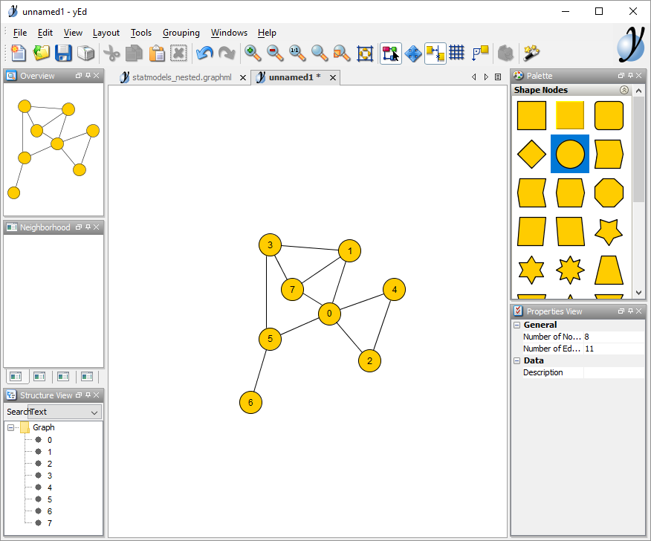
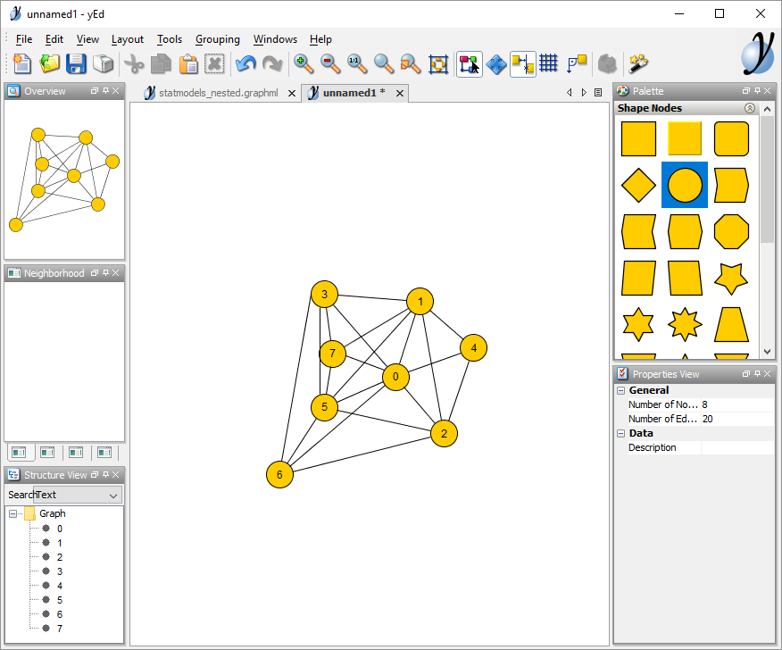
Statistical Models for Networks
ERGM: Model Specification
But note the model really says “more closed triads is good”
So if this is good…
..this is better!

Slide 62
Statistical Models for Networks
ERGM: Model Specification
..so what you really want is:
P(x=x)
Triangles
Or that there are marginal decreasing returns to each *additional* closed triad
GWESP

Slide 63
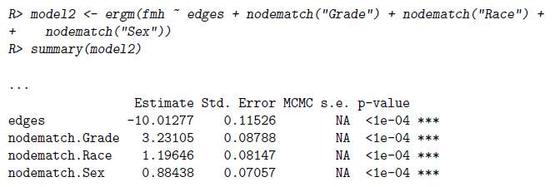
Statistical Models for Networks
ERGM: Model fitting
Running a model feels a lot like any general linear model:
Under the hood, it’s using a pseudo-=likelihood (logit) for models with only dyad-independent features, or fitting an MCMC if there are dependencies.

Slide 64
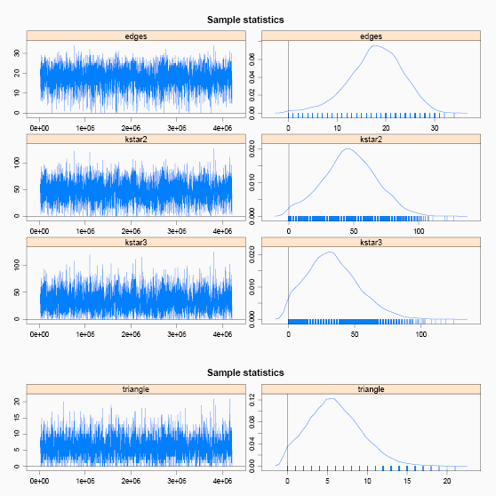
Statistical Models for Networks
ERGM: Model fitting
STATNET has a bunch of MCMC diagnostic tools. For example, you want to make sure your trace plots are nice and random, rather than trending in one direction or another…

Slide 65
Statistical Models for Networks
Modeling the network: ERGM - GOF
Once you have a model, the most common way to assess fit is to draw samples from the implied network space and compare them to your observed graph.

Slide 66
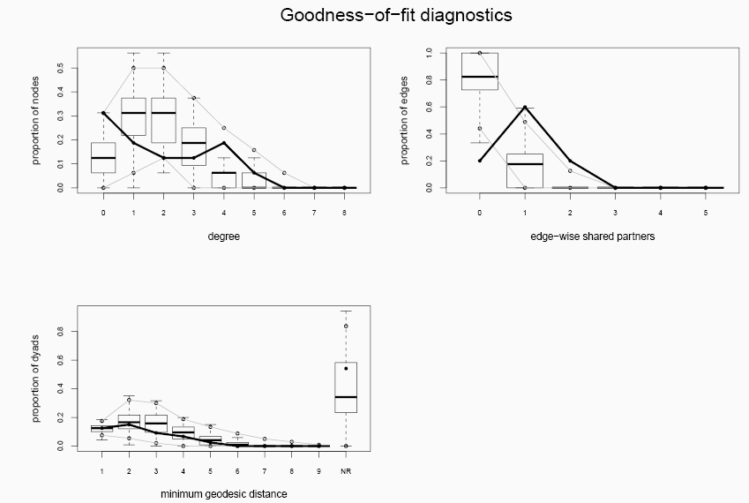
Statistical Models for Networks
Modeling the network: ERGM - GOF
Once you have a model, the most common way to assess fit is to draw samples from the implied network space and compare them to your observed graph.

Slide 67
Statistical Models for Networks
Modeling the network: ERGM - GOF

Slide 68
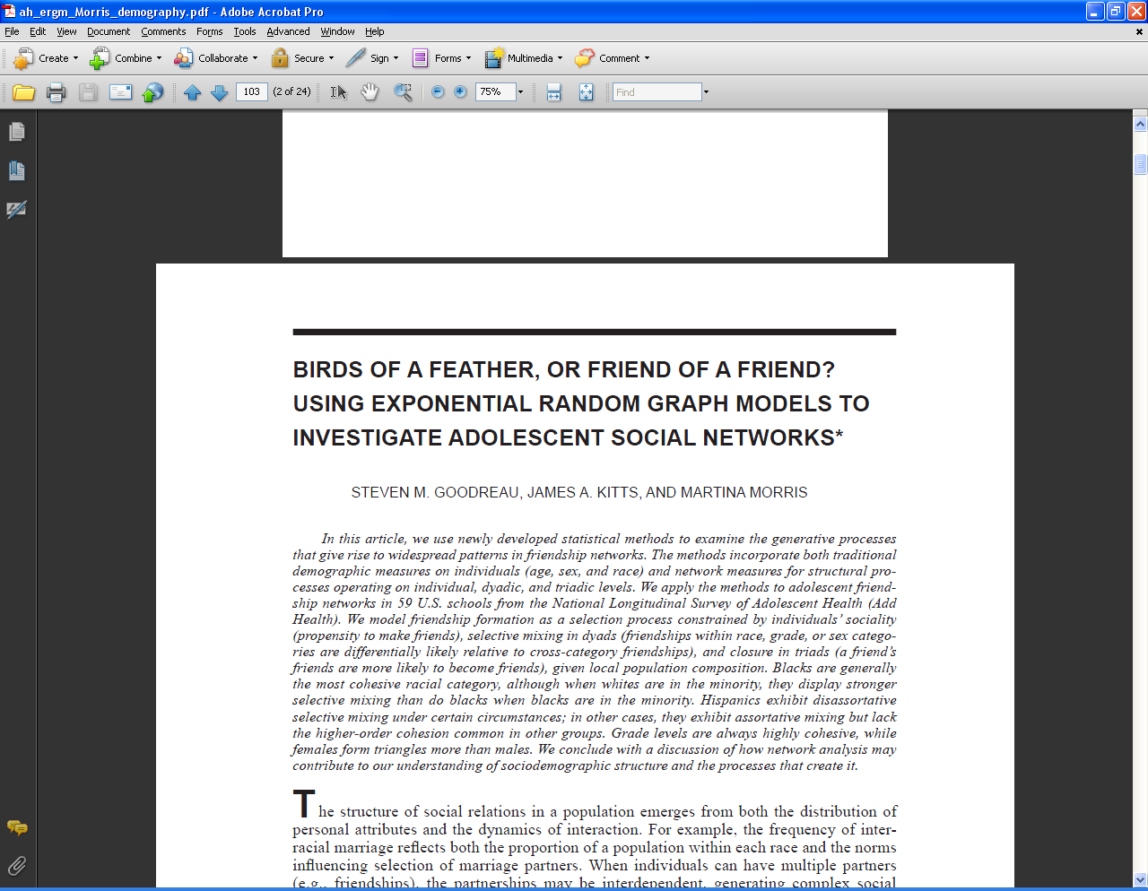
Statistical Models for Networks
Modeling the network: ERGM - example

Slide 69

Statistical Models for Networks
Modeling the network: ERGM - example

Slide 70
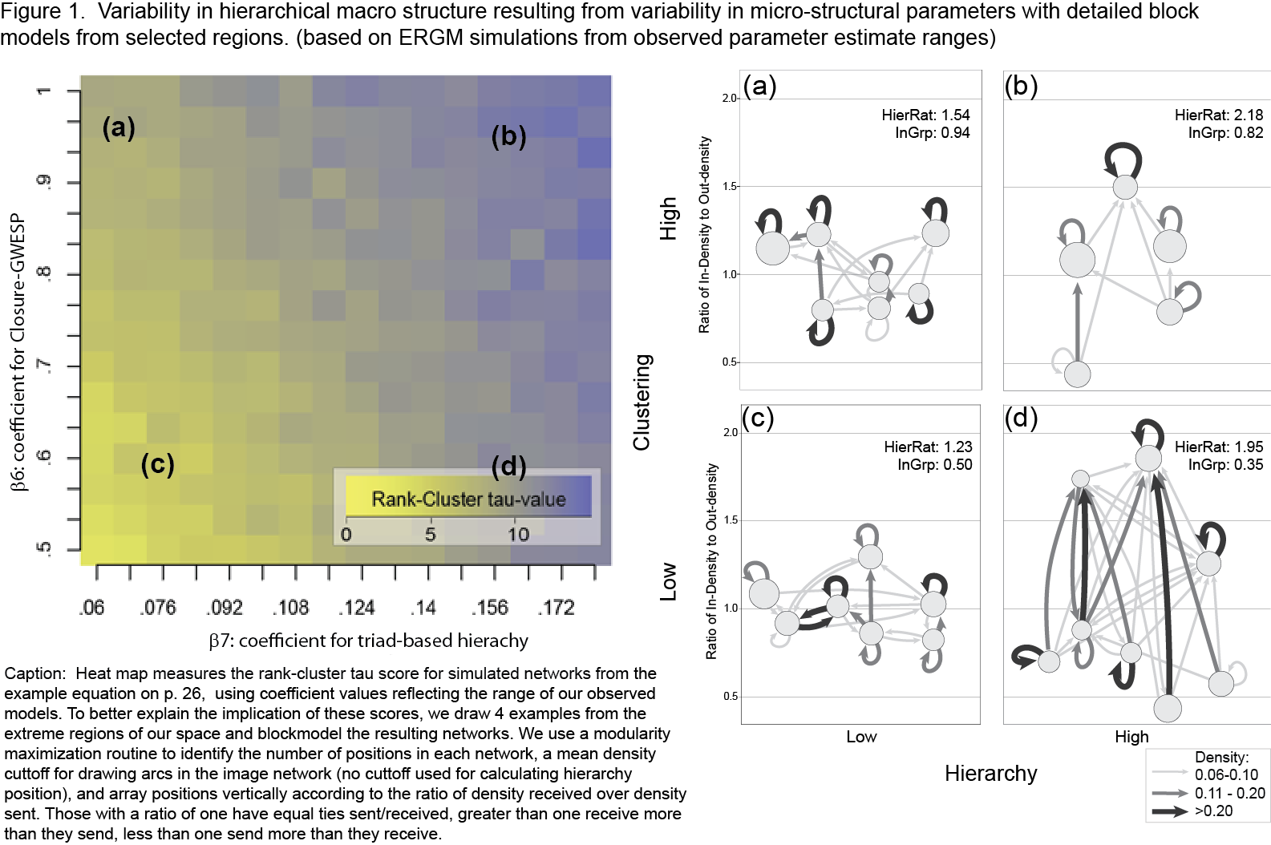
Statistical Models for Networks
Modeling the network: ERGM - example

Slide 71
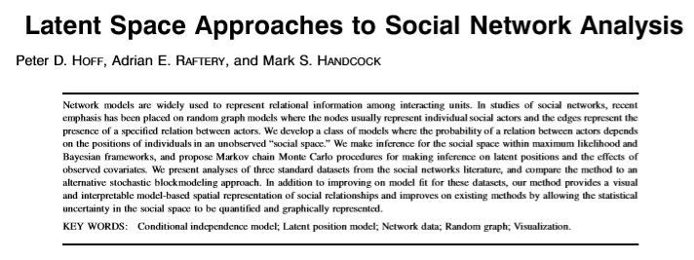
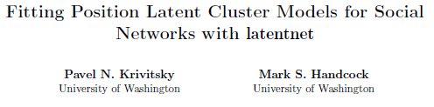
Introduction to Random & Stochastic
Latent Space Models

Slide 72
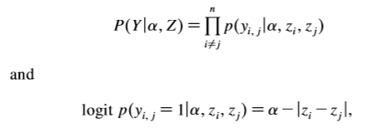
Introduction to Random & Stochastic
Latent Space Models
Simple latent distance model:
Given a distribution of points in the space defined by z, probability of a tie decreases with their distance in the latent space.
Z can be as many dimensions as you want; typically we try to fit the minimum number of dimensions that provide reasonable fit to the data.

Slide 73
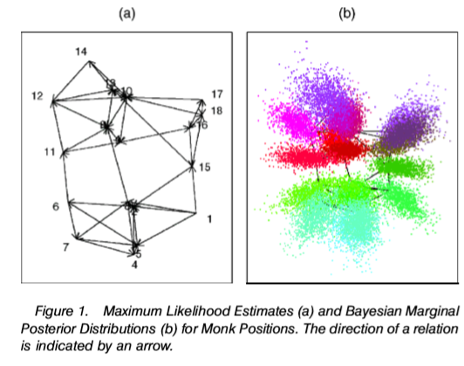
Introduction to Random & Stochastic
Latent Space Models
2d solution for Sampson monistary data

Slide 74
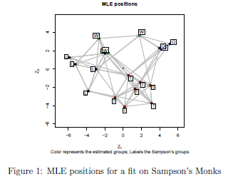
Introduction to Random & Stochastic
Latent Space Models: with groups
Z = a dimension in some unknown space that, once accounted for makes ties independent.
In addition, we can now embed z within a group structure, which adds probability of ingroup ties.

Slide 75
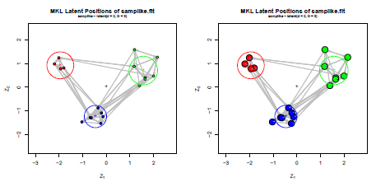
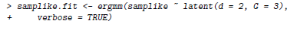
Introduction to Random & Stochastic
Latent Space Models

Slide 76
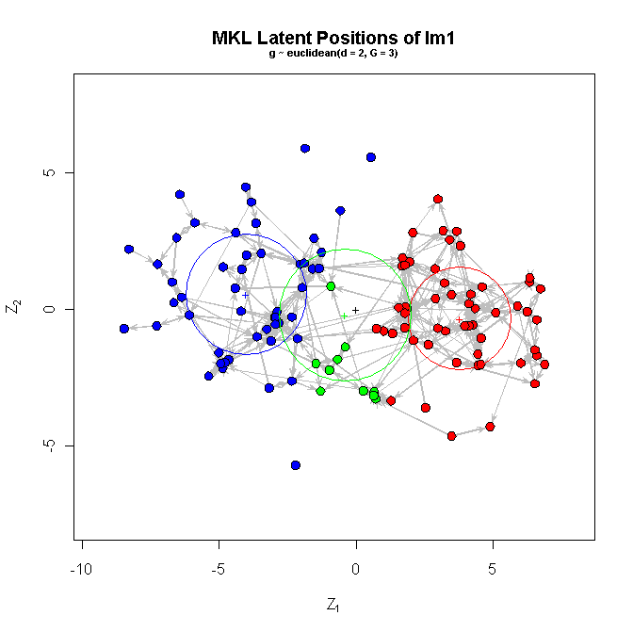
Introduction to Random & Stochastic
Latent Space Models
Example with the Prosper data, with three groups

Slide 77
Introduction to Random & Stochastic
Latent Space Models
Latent space models tend to be (a) much more robust to model specification errors than are ERGMs and (b) have better known convergance properties (i.e. you can prove that the models will converge, which follows because you’re making a conditional independence assumption that’s not made in ERGM).
But, you rarely know what the dimensions mean socially. So it provides a fit, but doesn’t test a mechanism.
This is a key difference; if you’re goal is out of sample prediction or simply controlling the “noise” of a network, a latent space model is probably the best solution. If your goal is to test a particular network mechanism, an ERGM is probably better.

Slide 78
Introduction to Random & Stochastic
Generalizations
AMEN: Additive & multiplicative effects models (Hoff & Volfovsky)
Basic social relations model
Dyad
effects
Row
effects
Column
effects
Row
error
Col
error
dyad
error
More general frame:
Latent
multiplicative
covariance
Model is very general; can deal with y on any scale (binary to real values), fits latent space & observed covariates.
Computationally intensive…

Slide 79

Introduction to Random & Stochastic
Generalizations
For more detail, see last year’s presentation by Alex!

